Slide 1
Textures
tutorial

Slide 2
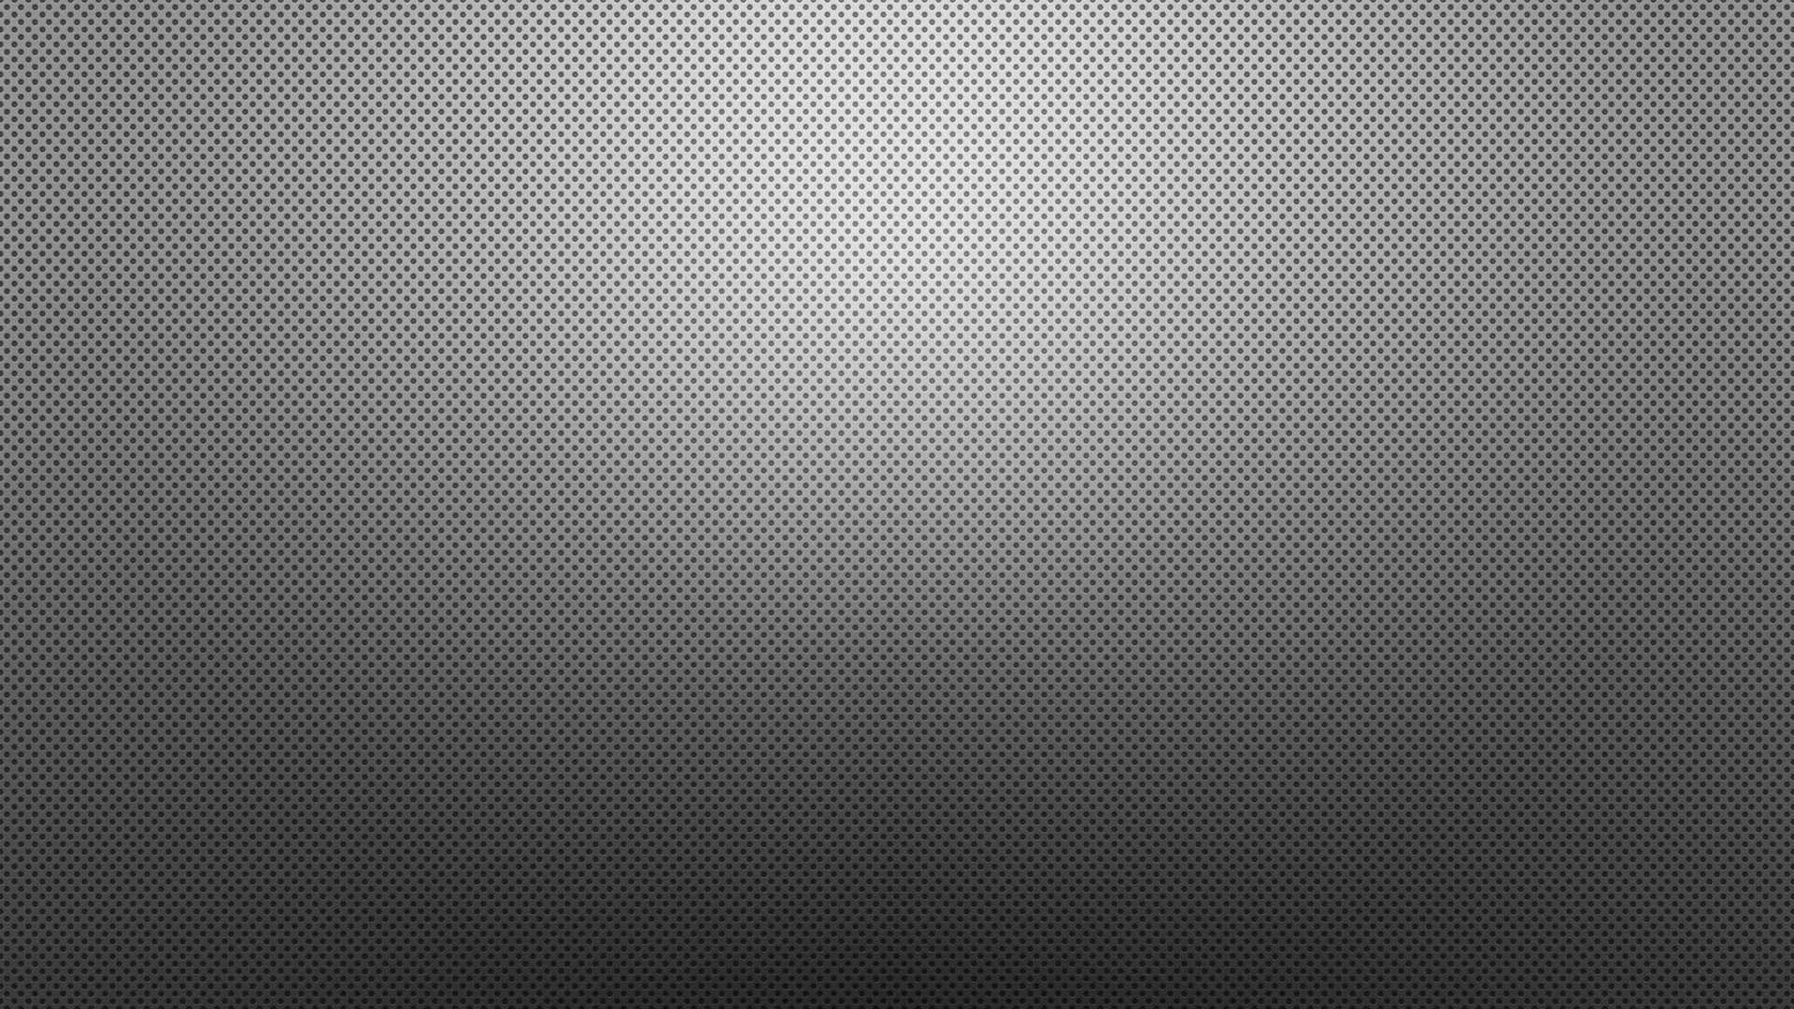
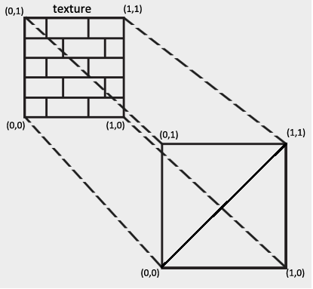
Texture Mapping
Apply an image to geometry
Add realism to the scene
Vertex have:
Position (x, y, z)
Normal (x, y, z)
UV cords (s, t)

Slide 3
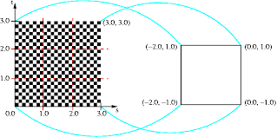
Steps for applying textures:
Load the positions, normal and Uvs into the buffer.
Load a texture file and put it into buffer.
Get the texture in fragment shader and apply.

Slide 4
Some important functions and codes:
glGenTextures(GLsizei n, GLuint *texture);
glBindTexture(GL_TEXTURE_2D, texture);
glTexImage2D(GL_TEXTURE_2D, 0, GL_RGB, width, height, 0, GL_RGB, GL_UNSIGNED_BYTE, data);
glActiveTexture(GL_TEXTURE0);
glTexParameteri(GL_TEXTURE_2D, GL_TEXTURE_MIN_FILTER, GL_NEAREST);
glTexParameteri(GL_TEXTURE_2D, GL_TEXTURE_MAG_FILTER, GL_LINEAR);

Slide 5
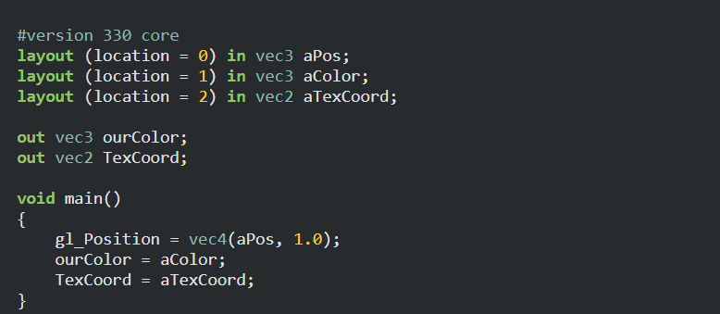
Vertex Shader

Slide 6
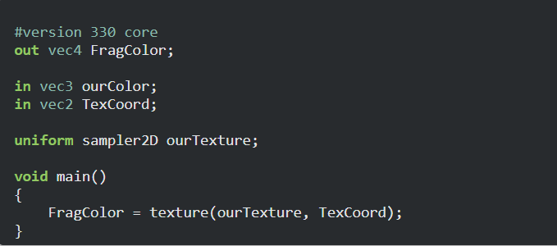
Fragment Shader

Slide 7
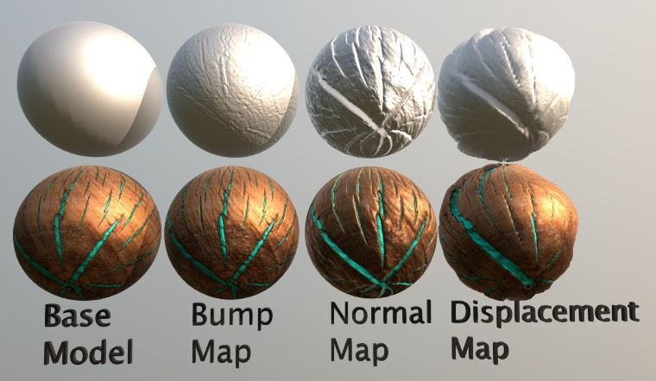
BUMP vs NORMAL vs DISPLACEMENT MAPPING

Slide 8
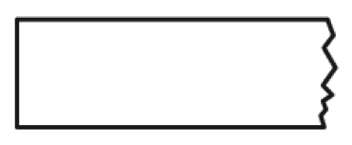
Need for Normal Mapping
Extra vertices, more complex geometry

Slide 9
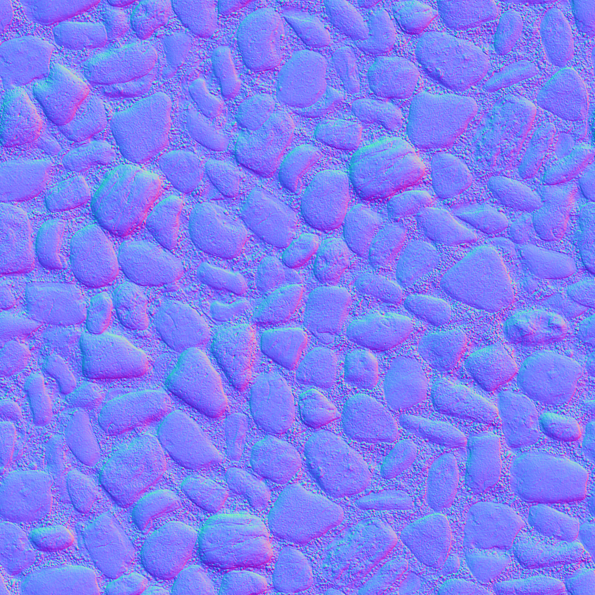
Normal Map

